Slide 1
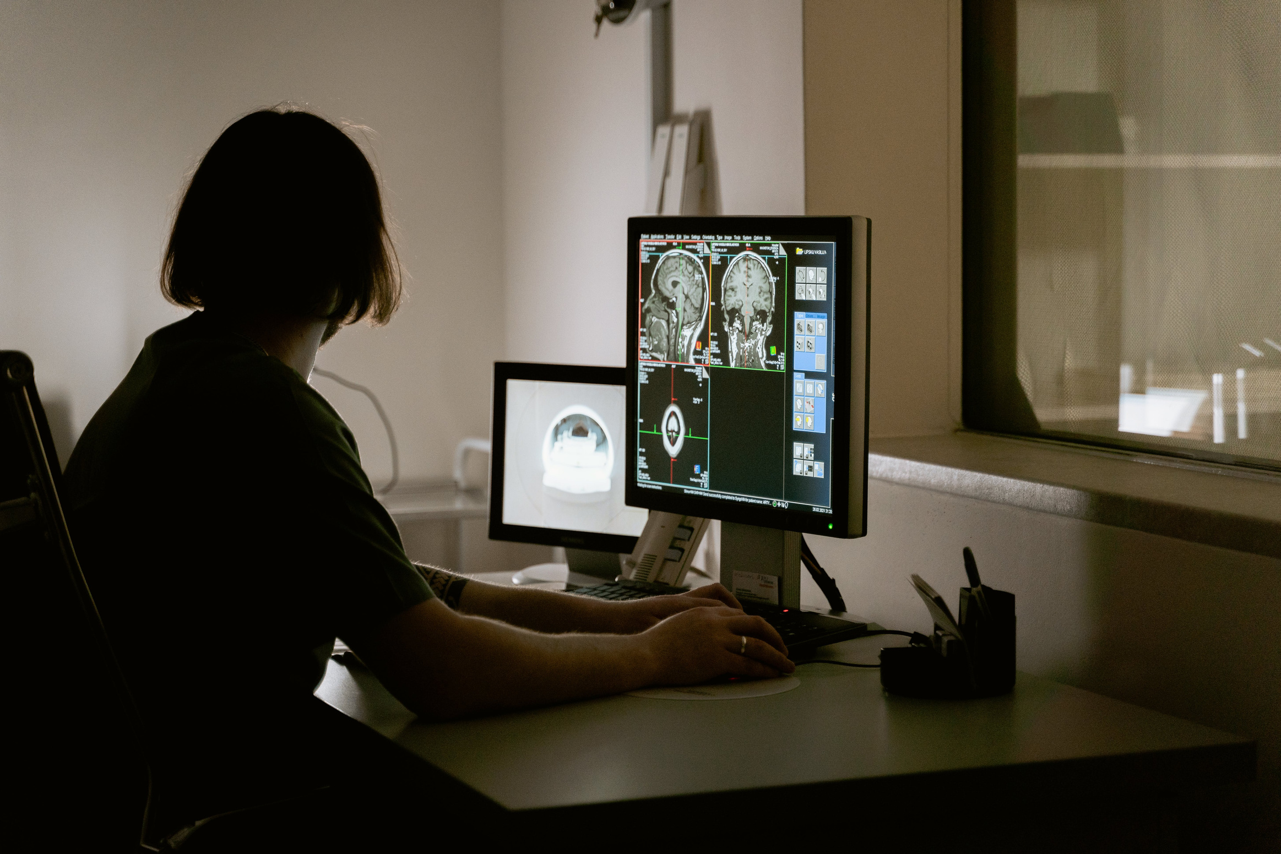
AI AND ALGORITHMSPROJECT

Slide 2
AI-Driven Algorithms for Brain Tumor Detection and Classification

Slide 3
GROUP MEMBERS
RAGHU VAMSI 22BDS014
SATHVIK REDDY 22BDS020
RAJ KUMAR 22BDS055
SUHAAS 22BDS056

Slide 4
CONTENT
Motivation
Introduction
Proposed Methodology
Results
Conclusion
References

Slide 5
Motivation
Brain tumors, a perilous form of cancer, affect individuals across all age groups.
Early detection is vital for better patient outcomes, but traditional methods like eye analysis of MRI data have inherent limitations.
The alarming 300% increase in brain tumor-related deaths over the past 30 years underscores the urgent need for timely identification.
Untreated brain tumors can lead to fatal consequences, emphasizing the critical importance of accurate and non-invasive diagnostic methods.
Magnetic Resonance Imaging (MRI) stands out as the most effective tool for diagnosing brain cancers.

Slide 6
Introduction
Data Types: It features MRI scans with annotations for tumor presence and type, supporting both binary and multi-class classification tasks.
Objective: Designed for training machine learning models to assist in automated brain tumor detection, the dataset helps improve diagnostic accuracy in healthcare.
Applications: This dataset is widely used to develop AI models that aid radiologists in identifying and diagnosing brain tumors efficiently.

Slide 7
Our Contributions
Overview
Extending prior work, our study implements state-of-the-art ML and deep learning algorithms.
Results
Improved accuracy, efficiency, and applicability in diverse scenarios.
Comparison:
Highlight key improvements or differences
Make predictions
Use visuals to enhance understanding

Slide 8
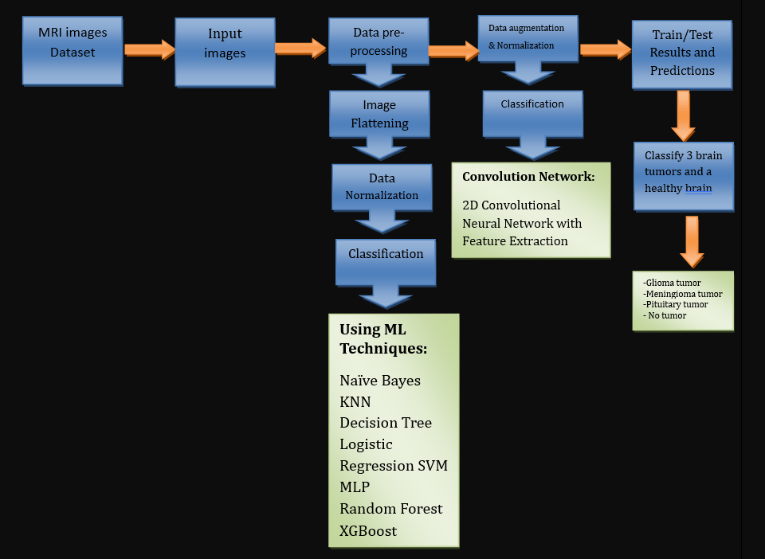
Proposed Methodology

Slide 9
Dataset Overview
The Br35H Brain Tumor Detection 2020 dataset on Kaggle consists of labeled MRI images for detecting and classifying brain tumors. It includes various tumor types such as glioma, meningioma, and pituitary tumors. The dataset is designed for training machine learning models to perform binary or multi-class classification, supporting automated diagnosis and tumor detection. Researchers use it to develop algorithms that assist healthcare professionals by improving diagnostic accuracy and efficiency in brain tumor identification and classification from MRI scans.

Slide 10
Machine Learning Models
SVC : Support Vector Classifier is a popular classification algorithm that separates data points by finding the optimal hyperplane in a high-dimensional feature space. It aims to maximise the margin between different classes while considering support vectors.
KNN : K-Nearest Neighbors is a non-parametric algorithm that classifies an input based on its nearest neighbours in the feature space. It assigns a class label to the input based on the majority vote of its k nearest neighbours.

Slide 11
Machine Learning Models
CNN : Convolution Neural Network excel in brain tumor detection by learning complex patterns in MRI images, achieving high accuracy, precision, recall, and AUC.
Random Forest : is an ensemble learning method that combines multiple decision trees to make predictions. Each decision tree is trained on a subset of the data, and the final prediction is determined by averaging or voting among the individual trees.

Slide 12
CODE SECTION

Slide 13
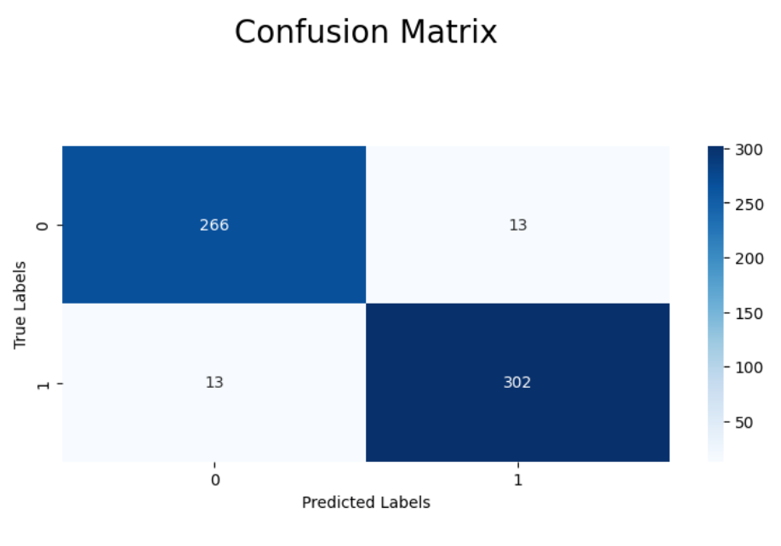
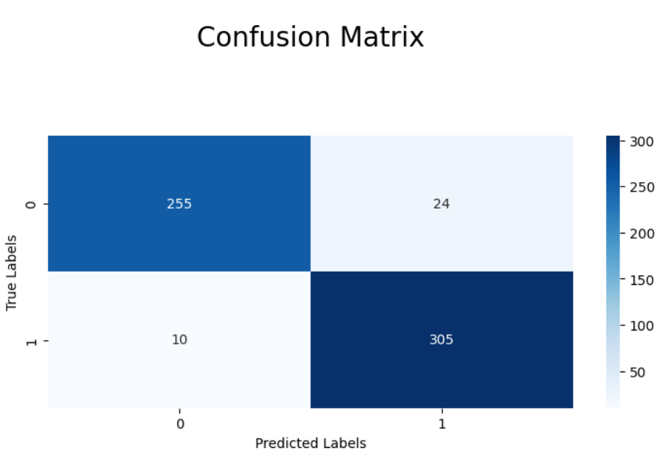
Confusion Matrix of ML Models
SVC Confusion Matrix
CNN

Slide 14
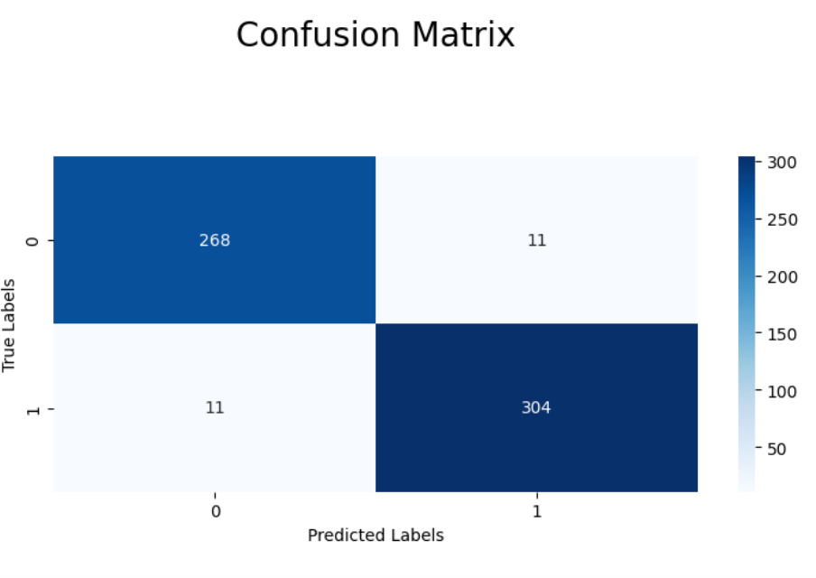
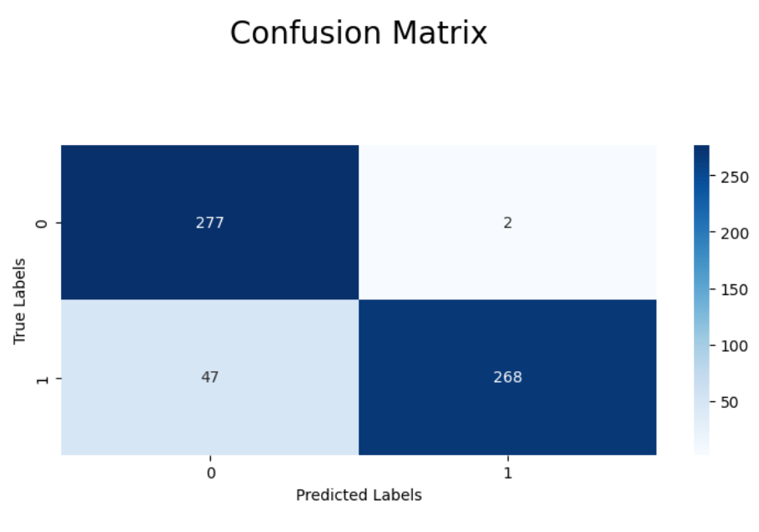
Confusion Matrix of ML Models
Random Forest Confusion Matrix
KNN Confusion Matrix

Slide 15
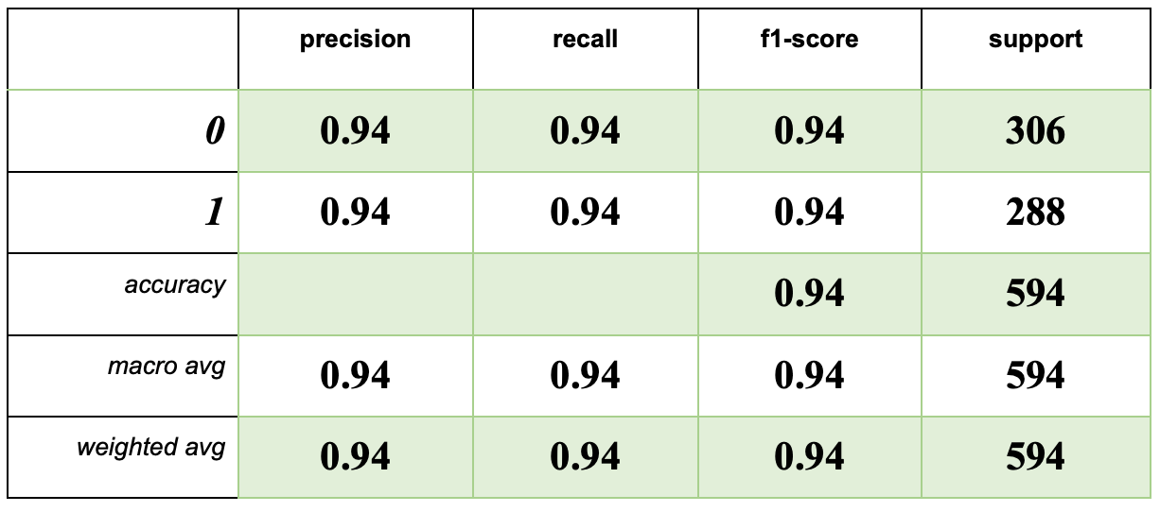
SVC Model

Slide 16
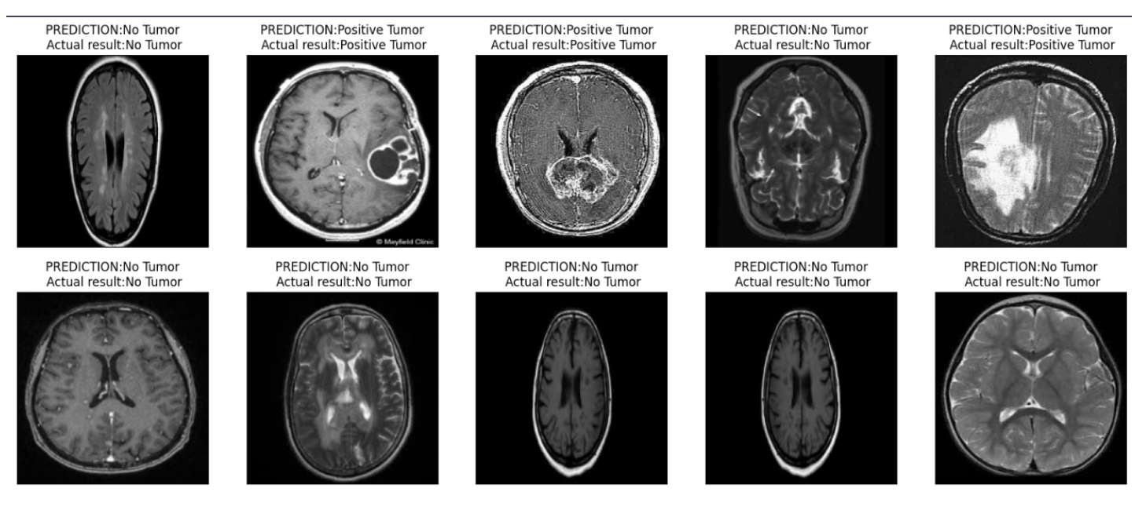
SVC model predictions

Slide 17
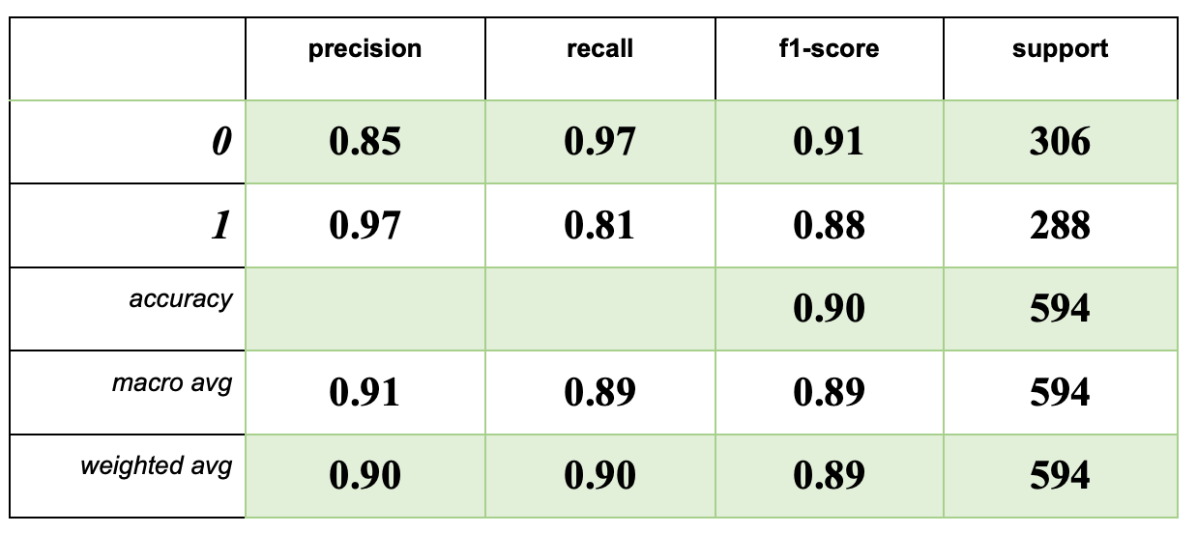
KNN Model

Slide 18
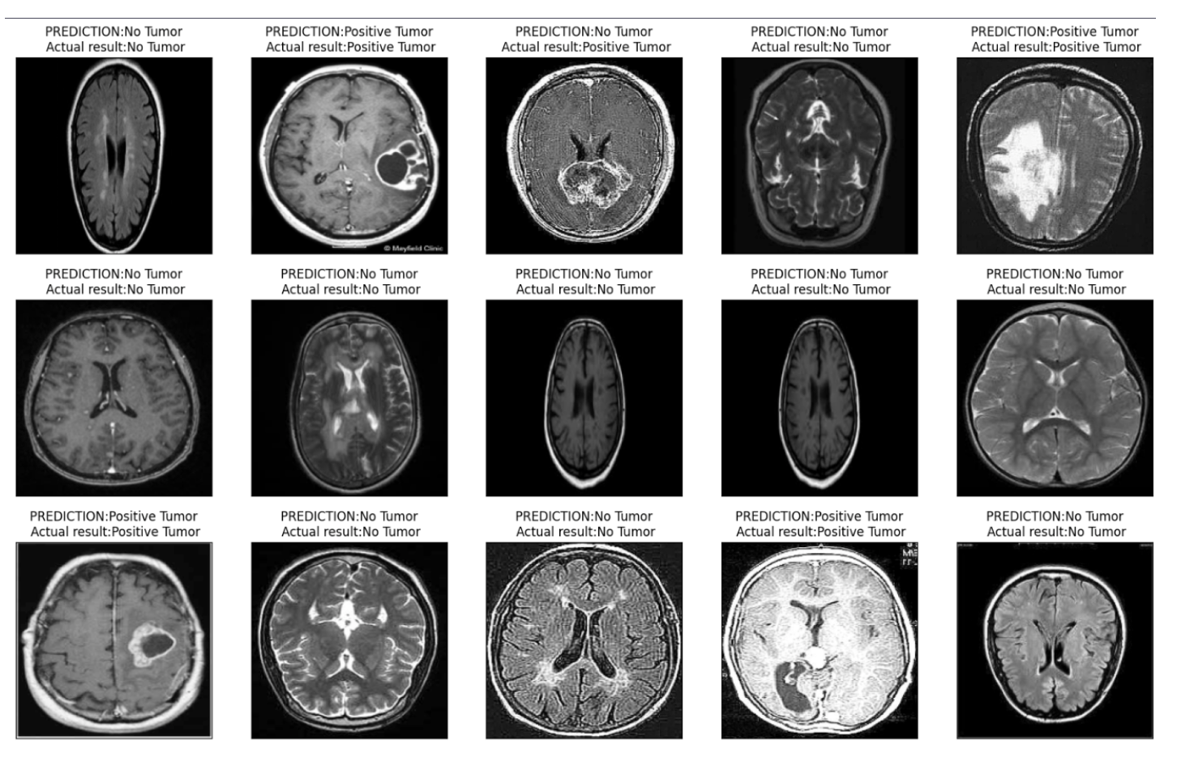
KNN model predictions

Slide 19
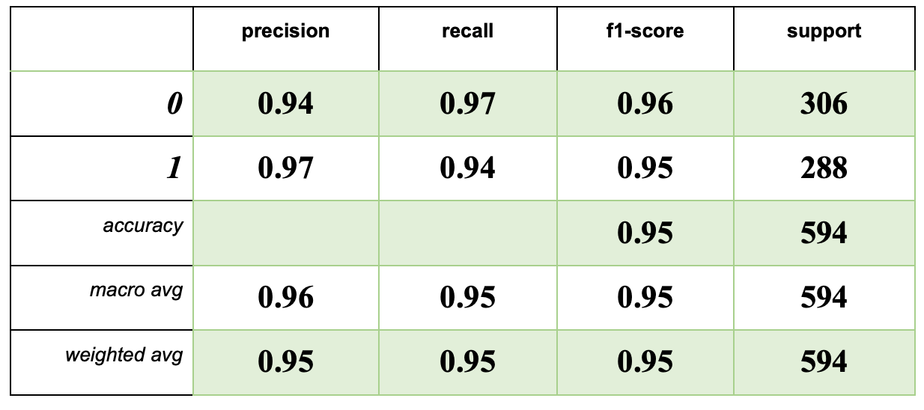
Convolutional Neural Network (CNN)

Slide 20
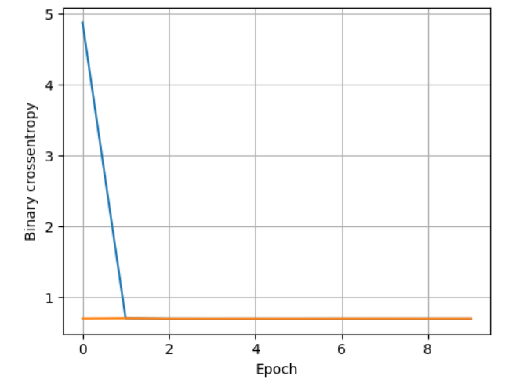
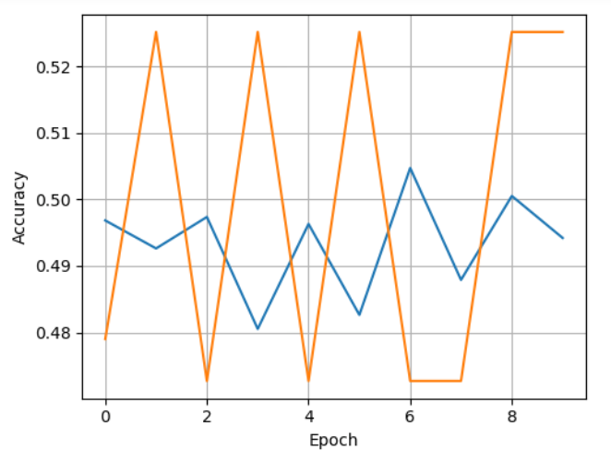
Results on CNN

Slide 21
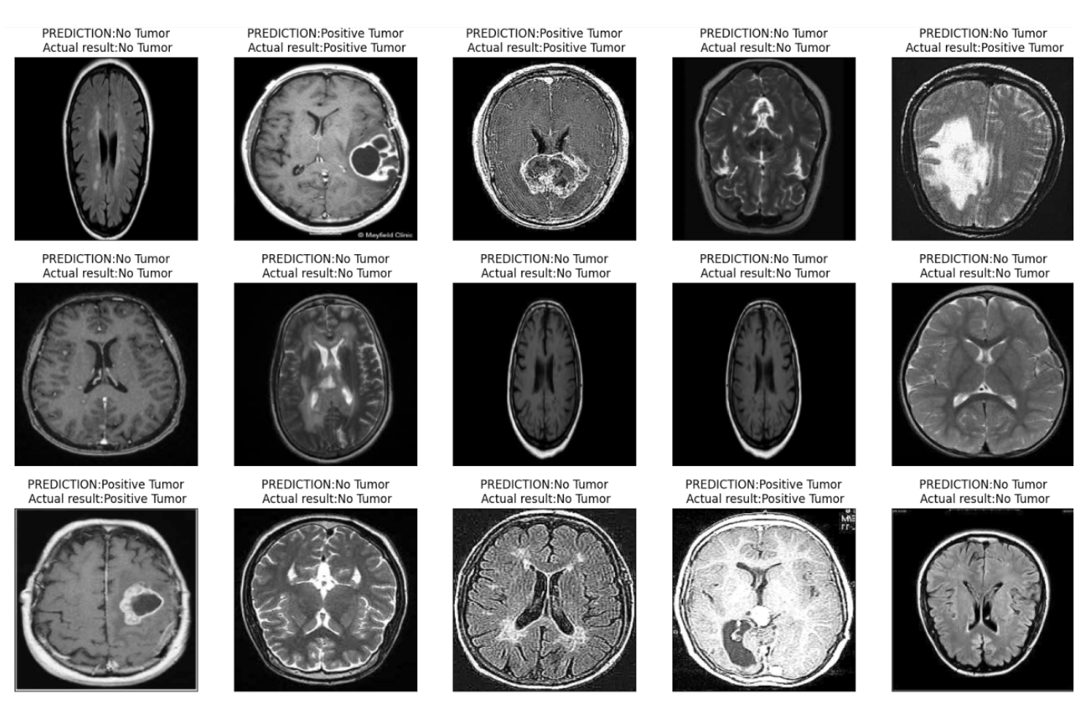
Model Predictions

Slide 22
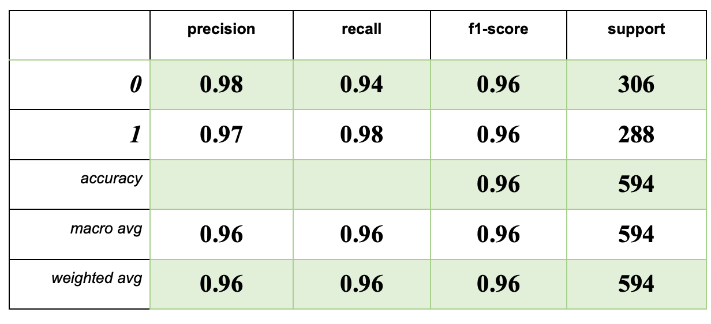
RANDOM FOREST

Slide 23
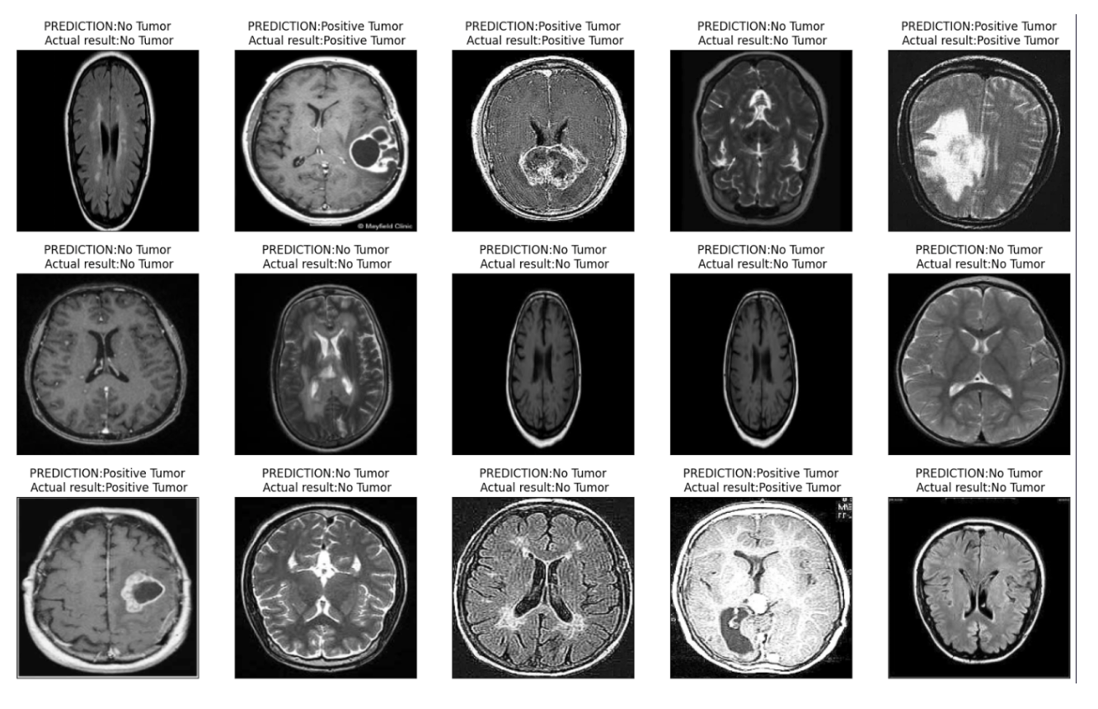
Random Forest predictions

Slide 24
Summary
Machine Learning Models:
Neural Networks, and Random Forest showcase the highest performance in terms of accuracy, precision, recall, and F1-score. These models effectively distinguish between tumour and no tumour images, providing reliable results.
SVC and kNN models also demonstrate respectable performance, maintaining a good balance between precision and recall. They achieve accuracy levels above 90%, making them viable alternatives for brain tumour detection.
The Random Forest model appears to be the best-performing mode

Slide 25
References
https://bmcmedinformdecismak.biomedcentral.com/articles/10.1186/s12911-023-02114-6#availability-of-data-and-materials
https://www.datacamp.com/tutorial/complete-guide-data-augmentation
https://link.springer.com/article/10.1007/s10044-017-0597-8#Sec2
https://www.academia.edu/36404652/Brain_Tumor_Detection_using_MRI_A_Review_of_Literature
https://www.kaggle.com/code/adilababayeva13/brain-tumor-detection-project/edit

Slide 26
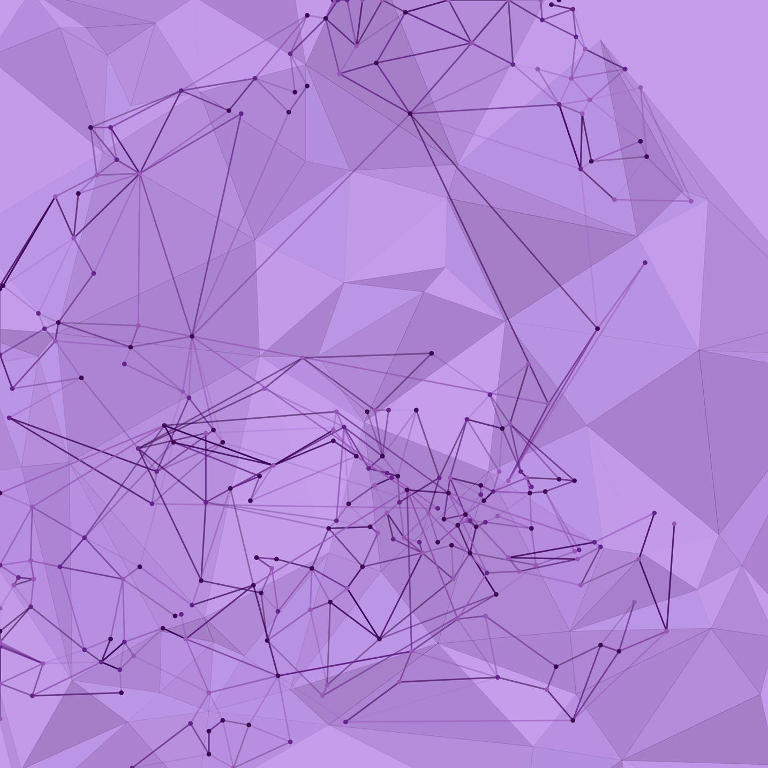
THANK
YOU
GitHub Repository

